Slide 1



E-commerce dataset- customer segmentation
Author : Saurabh Anand Date: Dec, 20 2017

Slide 2
Contents
Know the Client – Problem Statement and Solution
What’s the client current approach?
Project Objective
Data Acquisition and Description
Data Preparation
Data Wrangling and Exploratory Data Analysis
Dimensionality Reduction
Principle Component Analysis
Cluster Analysis- Machine Learning Algorithm
Conclusion and Summary

Slide 3


Know the Client – Problem Statement and Required Solution
Client Introduction
Our client is an online retailer based in the UK. They sell all-occasion gifts, and
many of their customers are wholesalers.
Problem statement and Required Solution
Most of their customers are from the UK, but they have a small percent of customers from other countries.
They want to create groups of these international customers based on their previous purchase patterns.
Their goal is to provide more tailored services and improve the way they market to these international customers

Slide 4
Contents
Know the Client – Problem Statement and Solution
What’s the client current approach?
Project Objective
Data Acquisition and Description
Data Preparation
Data Wrangling and Exploratory Data Analysis
Dimensionality Reduction
Principle Component Analysis
Cluster Analysis- Machine Learning Algorithm
Conclusion and Summary

Slide 5

What’s the client current approach?
Currently, the retailer simply groups their international customers by country. As you'll see in the project, this is quite inefficient because:
There's a large number of countries (which defeats the purpose of creating groups)
Some countries have very few customers.
This approach treats large and small customers the same, regardless of their purchase patterns

Slide 6
Contents
Know the Client – Problem Statement and Solution
What’s the client current approach?
Project Objective
Data Acquisition and Description
Data Preparation
Data Wrangling and Exploratory Data Analysis
Dimensionality Reduction
Principle Component Analysis
Cluster Analysis- Machine Learning Algorithm
Conclusion and Summary

Slide 7
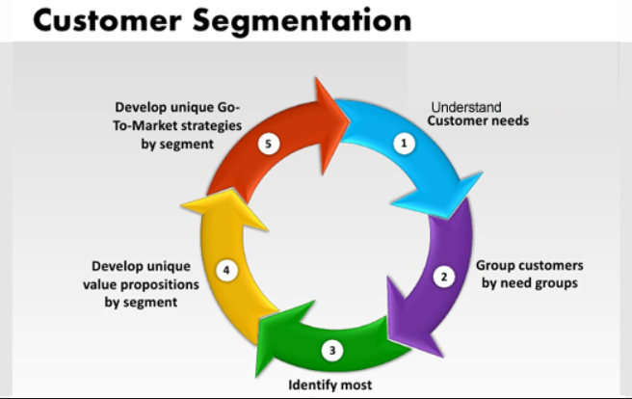
Project Objective
The retailer has hired us to help them create customer clusters, i.e. "customer segments," through a data-driven approach.
They've provided us a dataset of past purchase data at the transaction level.
Our task is to build a clustering model using that dataset.
Our clustering model should factor in both aggregate sales patterns and specific items purchased.

Slide 8
Contents
Know the Client – Problem Statement and Solution
What’s the client current approach?
Project Objective
Data Acquisition and Description
Data Preparation
Data Wrangling and Exploratory Data Analysis
Dimensionality Reduction
Principle Component Analysis
Cluster Analysis- Machine Learning Algorithm
Conclusion and Summary

Slide 9

Data Acquisition and Description
Data Description
InvoiceNo: Invoice number. Nominal, a 6-digit integral number uniquely assigned to each transaction. If this code starts with letter 'c', it indicates a cancellation.
StockCode: Product (item) code. Nominal, a 5-digit integral number uniquely assigned to each distinct product.
Description: Product (item) name. Nominal.
Quantity: The quantities of each product (item) per transaction. Numeric.
InvoiceDate: Invoice Date and time. Numeric, the day and time when each transaction was generated.
UnitPrice: Unit price. Numeric, Product price per unit in sterling.
CustomerID: Customer number. Nominal, a 5-digit integral number uniquely assigned to each customer.
Country: Country name. Nominal, the name of the country where each customer resides
Data Acquisition
This is a transnational data set which contains all the transactions occurring between 01/12/2010 and 09/12/2011 for a UK-based and registered non-store online retail. The company mainly sells unique all-occasion gifts. Many customers of the company are wholesalers

Slide 10
Contents
Know the Client – Problem Statement and Solution
What’s the client current approach?
Project Objective
Data Acquisition and Description
Data Preparation
Data Wrangling and Exploratory Data Analysis
Dimensionality Reduction
Principle Component Analysis
Cluster Analysis- Machine Learning Algorithm
Conclusion and Summary

Slide 11
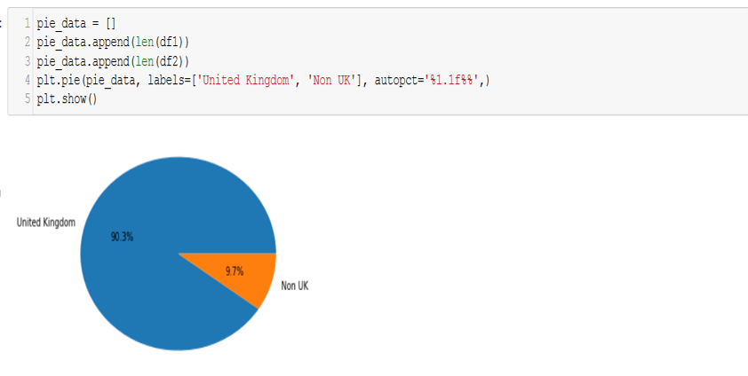
Data Preparation
Acquired data was loaded and was prepared for analysis. As, we can see the dataset contains most of the transactional record from UK, so we will create a dataframe for international transaction i.e other than United Kingdom for our analysis and solution

Slide 12
Contents
Know the Client – Problem Statement and Solution
What’s the client current approach?
Project Objective
Data Acquisition and Description
Data Preparation
Data Wrangling and Exploratory Data Analysis
Dimensionality Reduction
Principle Component Analysis
Cluster Analysis- Machine Learning Algorithm
Conclusion and Summary

Slide 13
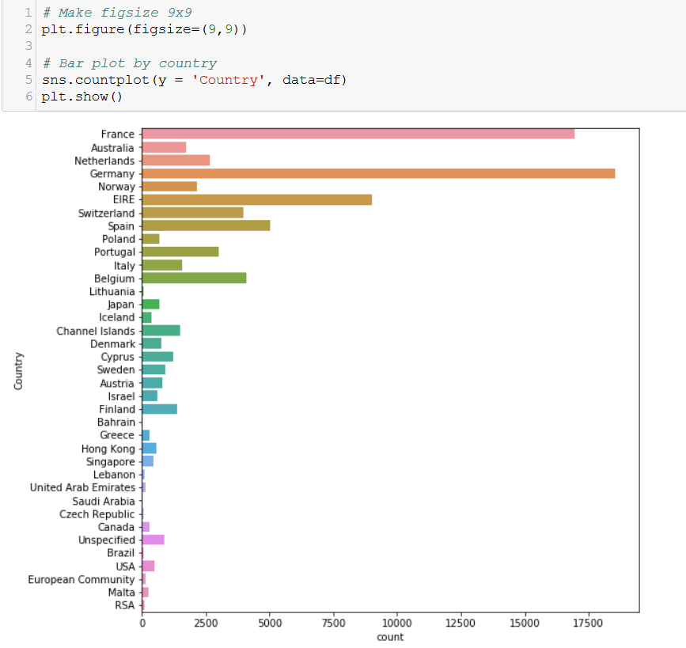
Data Wrangling and Exploratory Data Analysis
Even though we eventually want customer-level data, it's still helpful to do some basic exploratory analysis at the transaction level

Slide 14
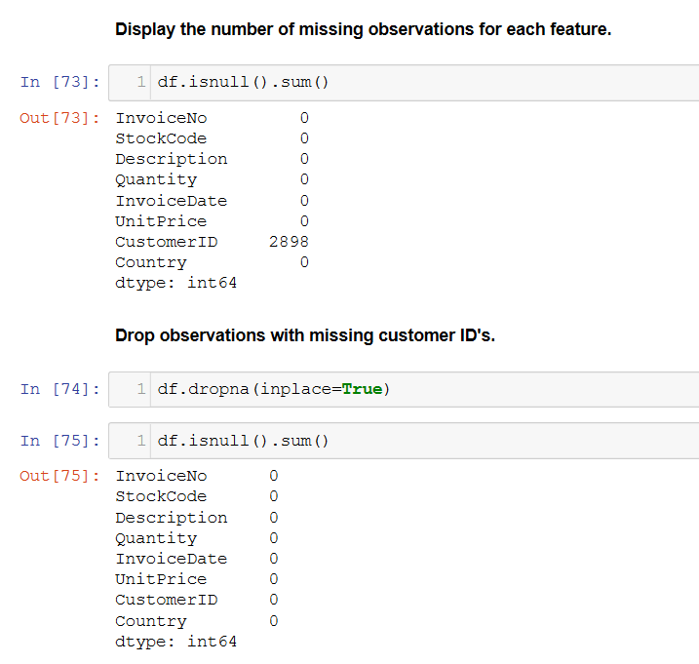
Data Cleaning
Data Cleaning-
Drop observations with missing customer ID's
Convert the CustomerID's and Invoice IDs from floats into strings
Saved the cleaned dataset into CSV

Slide 15
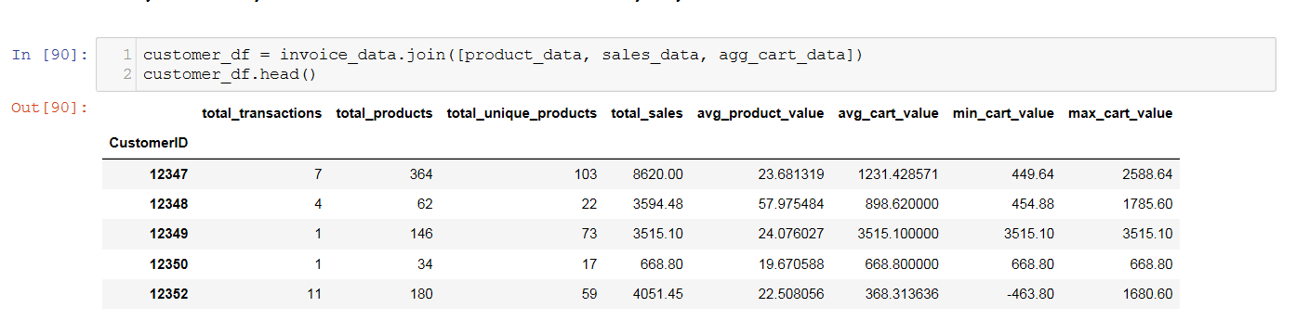
Data Aggregation
For the better analysis purpose all the possible data combination were done and data was rolled up at customer level following below steps
Aggregating product data by customer
Aggregate sales data by customer
Aggregating Cart data to Customer level
Joining All data frames created above and converted into a csv ‘Customer_df_analysis.csv’

Slide 16
Contents
Know the Client – Problem Statement and Solution
What’s the client current approach?
Project Objective
Data Acquisition and Description
Data Preparation
Data Wrangling and Exploratory Data Analysis
Dimensionality Reduction
Principle Component Analysis
Cluster Analysis- Machine Learning Algorithm
Conclusion and Summary

Slide 17
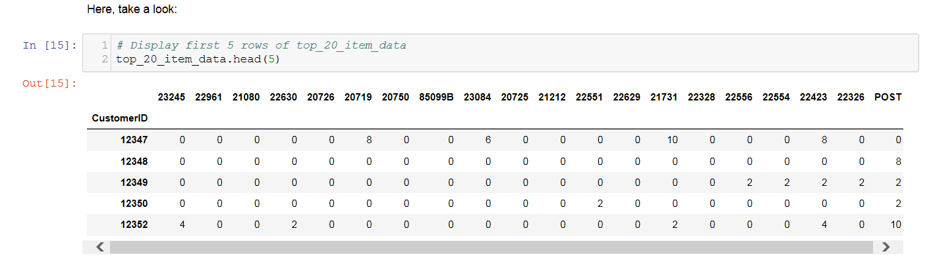
Dimensionality Reduction
As, our client wishes to incorporate information about specific item purchases into the clusters. For example, our model should be more likely to group together customers who buy similar items.
Now, we prepared individual item features for our clustering algorithms.
We'll introduce a simple way to reduce the number of dimensions by applying thresholds
Below are the steps used as a part of dimensionality reduction-
Import Cleaned dataset
Applied Toy example on sample data for reduce dimensionality
Applied Toy example to entire dataset- High Dimensionality
Created a Threshold to reduce dimensionality of entire dataframe

Slide 18
Contents
Know the Client – Problem Statement and Solution
What’s the client current approach?
Project Objective
Data Acquisition and Description
Data Preparation
Data Wrangling and Exploratory Data Analysis
Dimensionality Reduction
Principle Component Analysis
Cluster Analysis- Machine Learning Algorithm
Conclusion and Summary

Slide 19
Principle Component Analysis
Principal Component Analysis, or PCA, is a popular dimensionality reduction technique.
PCA seeks to create new features by finding linear combinations of your original ones. These new features, called principal components, are meant to maximize the "explained variance," which we'll explain further in the module.
Here, we'll prepare individual item features for our clustering algorithms, except this time we'll use PCA instead of thresholding.
PCA is especially effective when you have many correlated features.
Note- PCA creates new features that replace the original ones.
Below are the steps performed
Item data - Principal Component Analysis
Explained Variance
Dimensionality Reduction

Slide 20
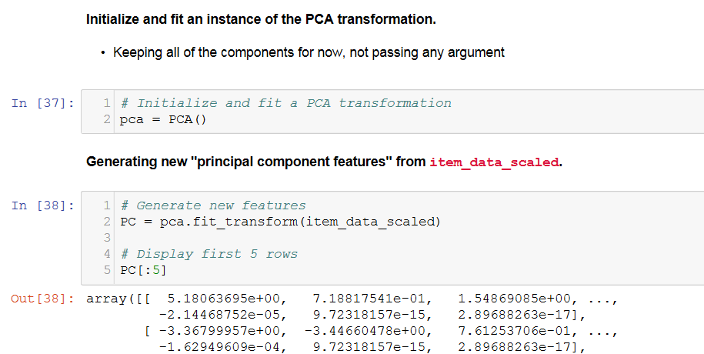
Principle Component Analysis(Contd)
Item data - Principal Component Analysis
Scaled item_data, which we saved before and named it ‘item_data_scaled’
Next, initialize and fit an instance of the PCA transformation and generate new "principal component features" from item_data_scaled.

Slide 21
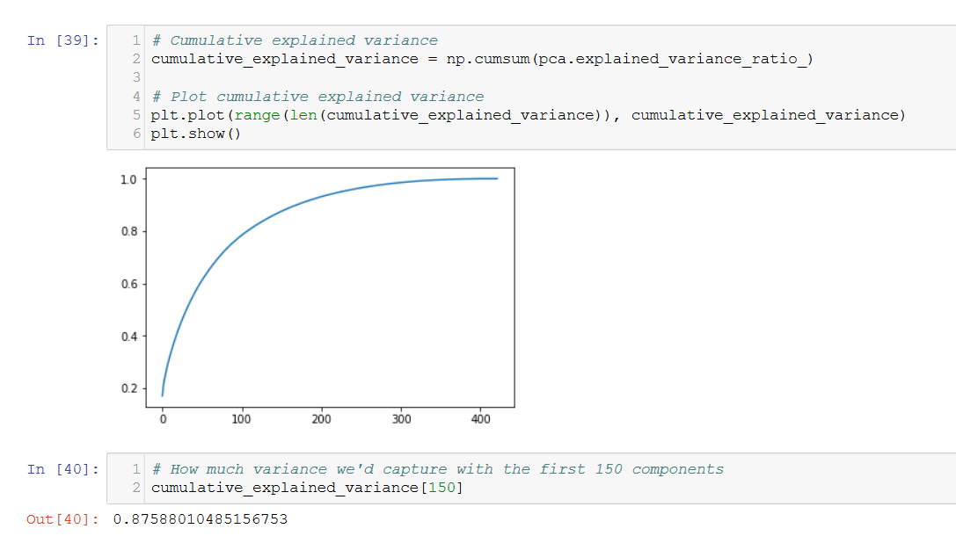
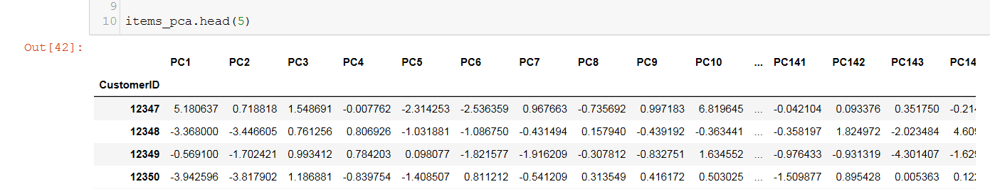
Principle Component Analysis(Contd)
Explained Variance
It's very helpful to calculate and plot the explained variance. This will tell us the total amount of variance we'd capture if we kept up to the n-th component.
First, we'll use np.cumsum() to calculate the cumulative explained variance.
Then, we'll plot it so we can see how many features we'd need to keep in order to capture most of the original variance.
Initialize and fit another PCA transformation with 150 components and save it as ‘pca_item_data.csv’

Slide 22
Contents
Know the Client – Problem Statement and Solution
What’s the client current approach?
Project Objective
Data Acquisition and Description
Data Preparation
Data Wrangling and Exploratory Data Analysis
Dimensionality Reduction
Principle Component Analysis
Cluster Analysis- Machine Learning Algorithm
Conclusion and Summary

Slide 23
Cluster Analysis- Machine Learning Algorithm
Cluster Analysis
For clustering problems, the chosen input features are usually more important than which algorithm you use.
Here, we'll apply the K-Means algorithm to 3 different feature sets for comparison
Import 3 CSV files we've saved before
'Customer_df_analysis.csv' as base_df.
'threshold_item_data.csv' as threshold_item_data.
'pca_item_data.csv' as pca_item_data.
Feature1- Result after applying K-Means algorithm to base_df with random_seed=126 and three cluster
Feature2- Result after applying K-Means algorithm to threshold_item_data with random_seed=126 and three cluster
Feature3- Result after applying K-Means algorithm to pca_item_data with random_seed=126 and three cluster

Slide 24
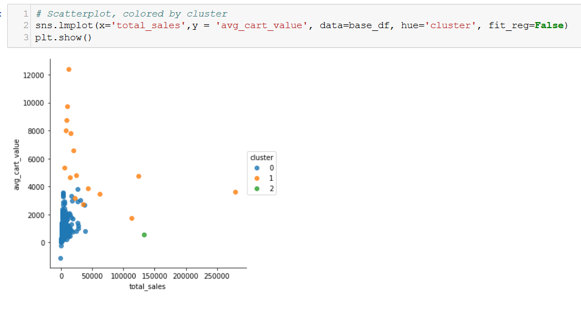
Cluster Analysis- Machine Learning Algorithm(Contd)
Cluster Analysis- Feature 1
Result after applying K-Means algorithm to base_df with random_seed=126 and three cluster

Slide 25
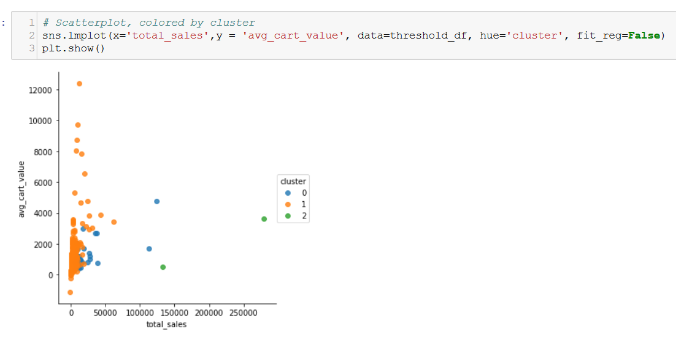
Cluster Analysis- Machine Learning Algorithm(Contd)
Cluster Analysis- Feature 2
Result after applying K-Means algorithm to threshold_item_data with random_seed=126 and three cluster

Slide 26
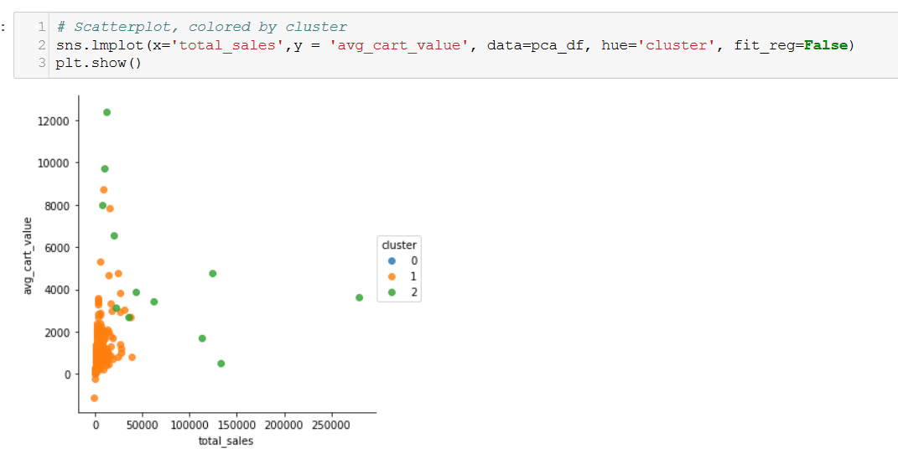
Cluster Analysis- Machine Learning Algorithm(Contd)
Cluster Analysis- Feature 3
Result after applying K-Means algorithm to pca_item_data with random_seed=126 and three cluster

Slide 27
Cluster Analysis- Machine Learning Algorithm(Contd)
Cluster Analysis- Feature 3
Result after applying K-Means algorithm to pca_item_data with random_seed=126 and three cluster

Slide 28
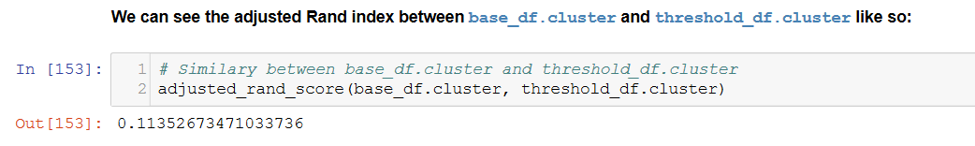
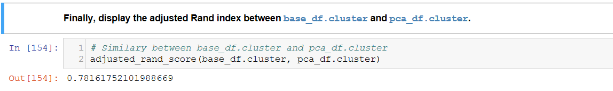
Model Comparison
Comparing features developed before using scikit learn- adjusted randon score as below-
1.Compare base_df.cluster and threshold_df.cluster
2. Compare base_df.cluster and pca_df.cluster

Slide 29
Contents
Know the Client – Problem Statement and Solution
What’s the client current approach?
Project Objective
Data Acquisition and Description
Data Preparation
Data Wrangling and Exploratory Data Analysis
Dimensionality Reduction
Principle Component Analysis
Cluster Analysis- Machine Learning Algorithm
Conclusion and Summary

Slide 30

Result Summary and Conclusion
The first stage of this work consisted in dimensionality reduction to incorporate specific item purchases and build a platform to apply clustering algorithm.
The second stage of this work was aimed to perform principle component analysis which is a unique way of dimensionality reduction and prepare individual item features for our clustering algorithms
In the final stage, we applied K-Means algorithm to the different features built and performed the model comparison.
Based on the adjusted random score while comparing base and threshold cluster with that of PCA, and it was found that base data frame was much closer to PCA data frame.
The performance of the classifier therefore seems correct given the potential shortcomings of the current model

Slide 31


